Slide 1
Core Java – Class 6

Slide 2
Topics
Abstract classes
Interfaces
Packages
Pass by value and reference
Exception Handling

Slide 3
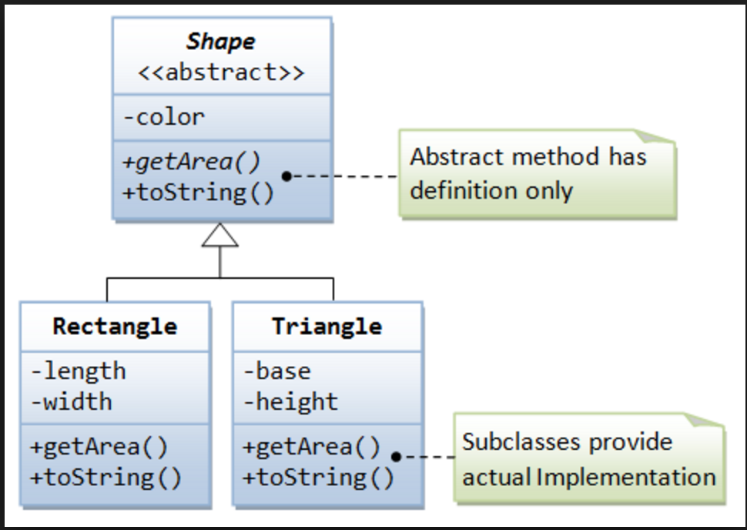
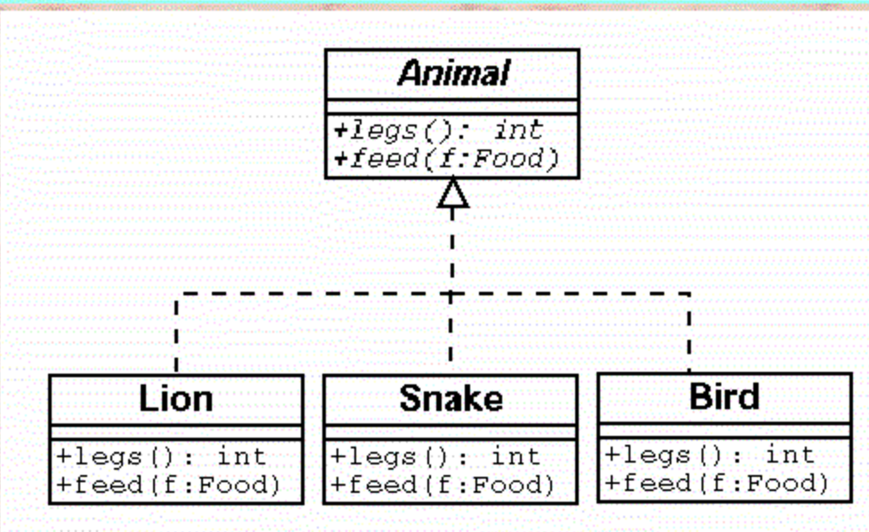
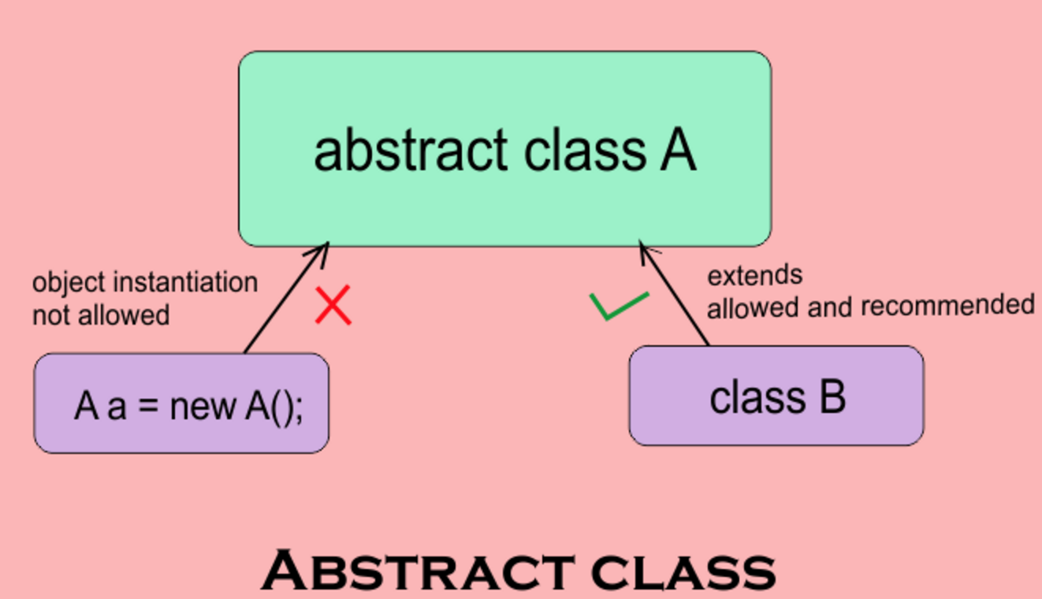
Abstract class
Typically, the base classes in an class hierarchy are abstract
Concepts (or classes) like Furniture, Vehicle, Engineer, Phone, Food, Drink, Animal are abstract
Keyword “abstract” is added in front of the abstract classes and they can’t be created using new
Abstract classes can have abstract methods – abstract methods only have method definition but no implementation in them

Slide 4
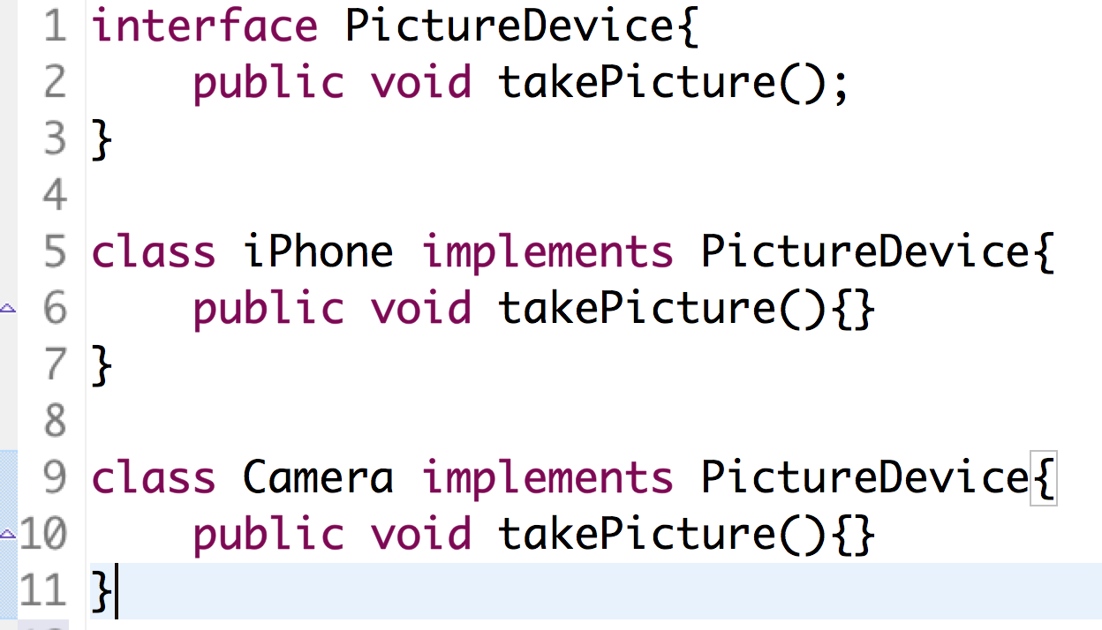
Interfaces
Interface is a contract of a Class and provides a specification for the users of a class.
Interface contains only method definitions but no implementations
Classes implementing an interface has to implement all the methods defined in the interface. Class implements interface using “implements” keyword
A class can implement multiple interfaces
A class can also implement a few methods of the interface but that class will be abstract and can’t be created using new

Slide 5
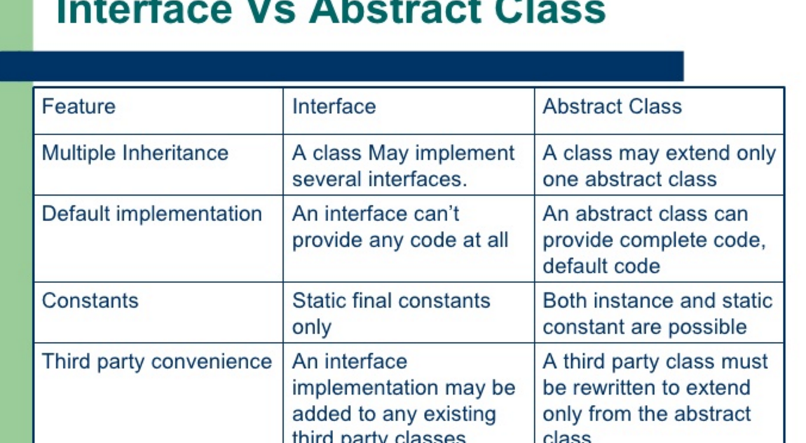
Interface Vs Abstract class

Slide 6
Packages
A package is a logical organization of related components (classes or interfaces)
Java classes can be logically organized into packages
Java Library provides standard packages like java.util, java.lang, java.io etc

Slide 7
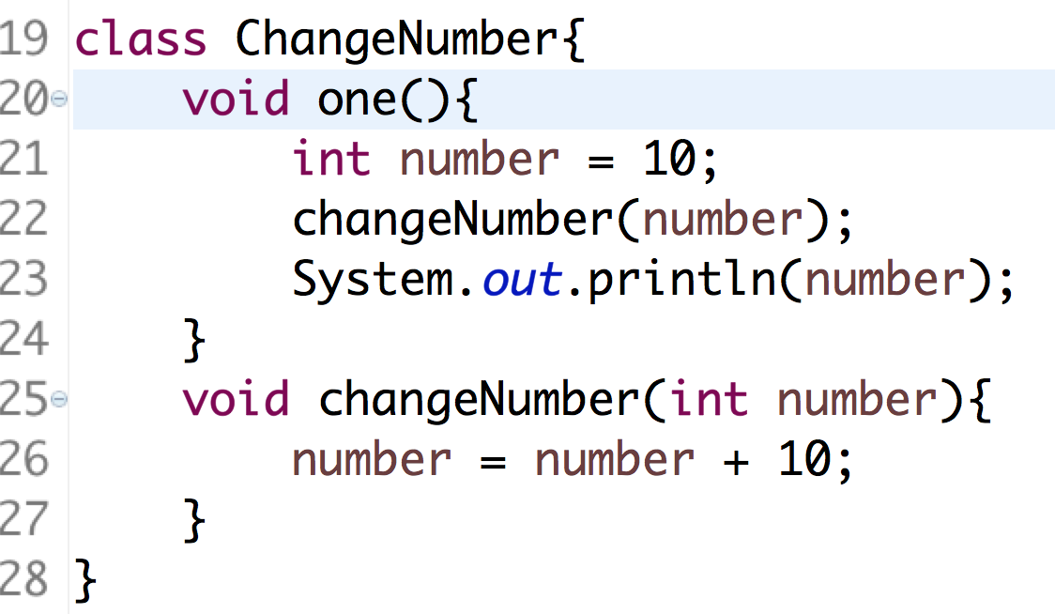
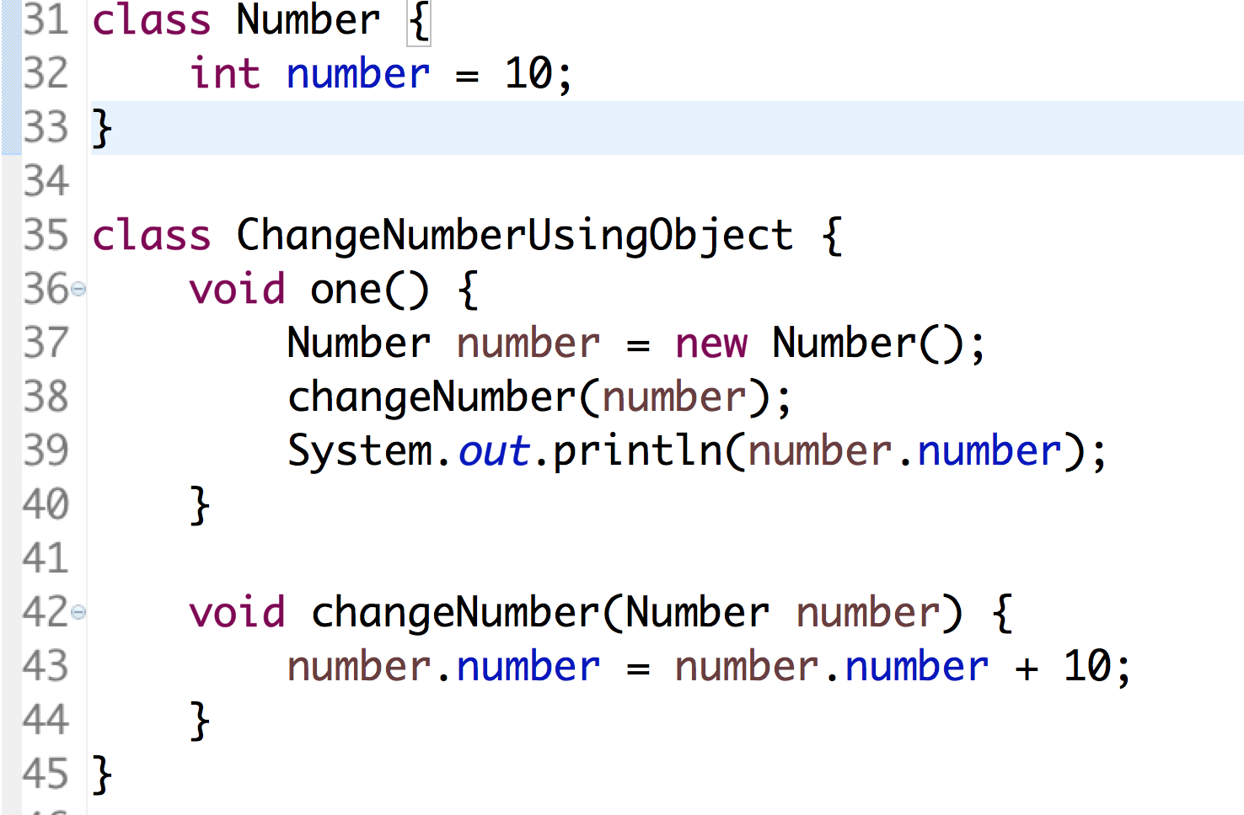
Pass by value and reference
Variables or primitive data types are passed by values in method calls
Objects are passed by references in method calls

Slide 8
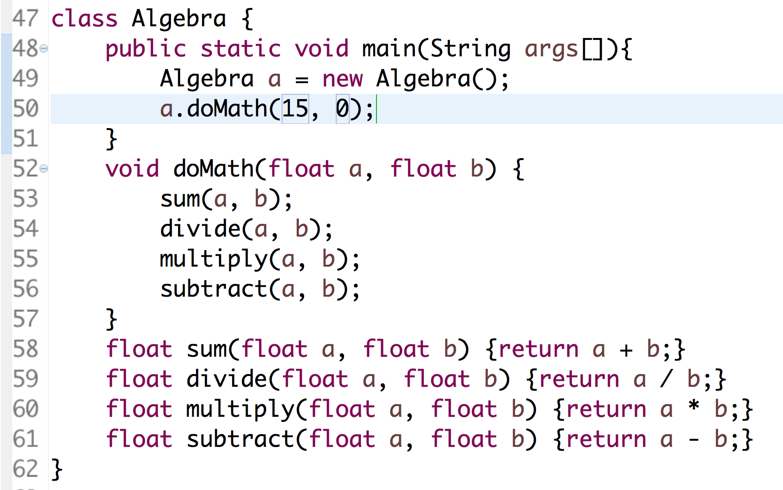
Exception Handling
Exception is a situation when something unexpected happens while executing code
Java provides mechanisms to handle exceptions

